Slide 1
Why 2 Million Developers Depend on Mule
1

Slide 2
What and Why ESB?
What is an ESB?
Why do we need to use it?
What challenges it can solve?
What is Mule?

Slide 3
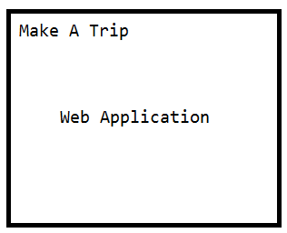
Example scenario
https://www.makemytrip.com
http://www.yatra.com
https://www.tripadvisor.com

Slide 4
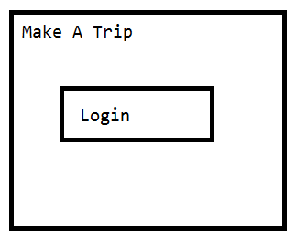
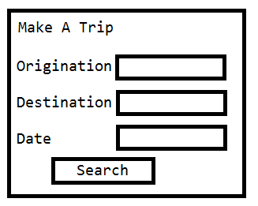
Features of MakeATrip
Login into MakeATrip
Search flights and book tickets

Slide 5
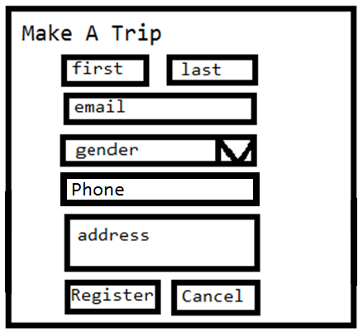
Registration module
In order to login, customer must register into the MakeATrip
Registration process is very tedious.

Slide 6
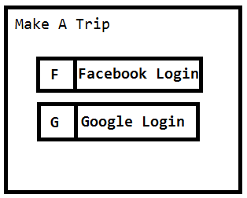
Login Module
Customers expect flexible authentication like Login through Google and Facebook.

Slide 7
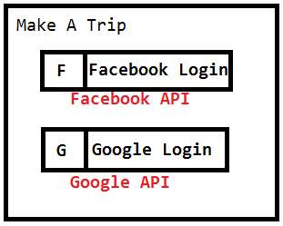
APIs to be used
Facebook API and Google API need to be used in MakeATrip application in order to incorporate the Login through Social media option.

Slide 8
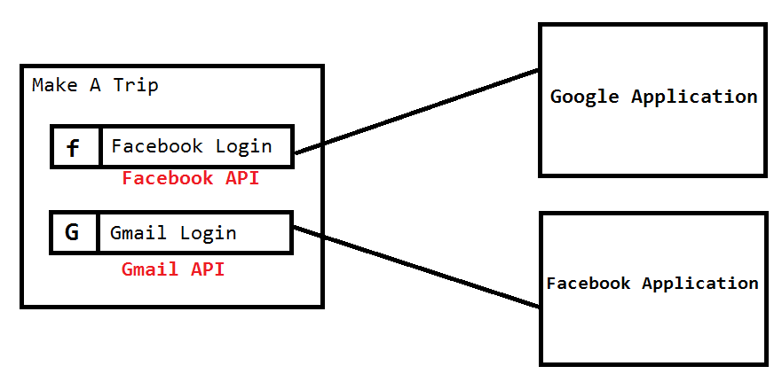
Application Integrations
The application should integrate with Google application and Facebook application

Slide 9
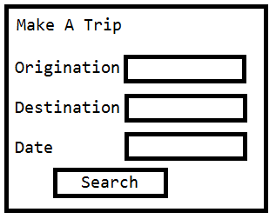
Search and Book tickets
To Search and book tickets, customer must enter the origination, destination and date of travel.
On click of search button, MakeATrip app should internally contact various flight operators, gather all flights information and render the response to the customer.

Slide 10
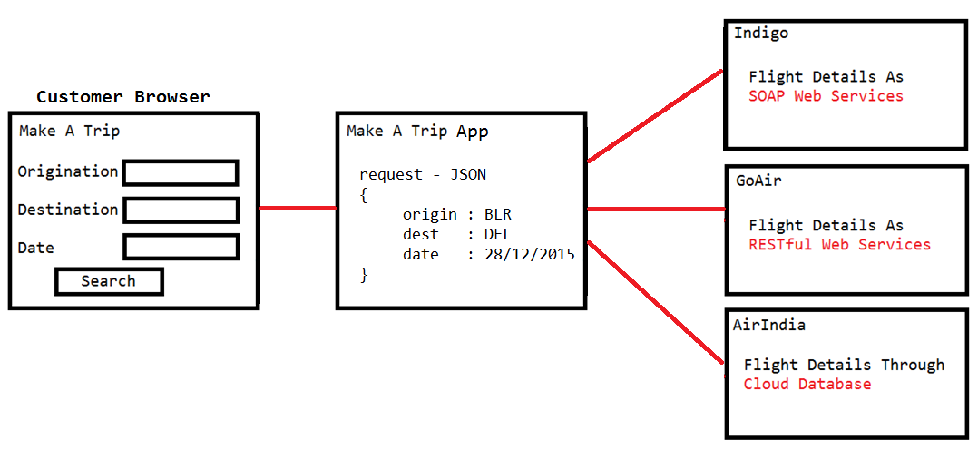
So MakeATrip App must be integrated with various types of other applications like Indigo, GoAir and AirIndia in this case.

Slide 11
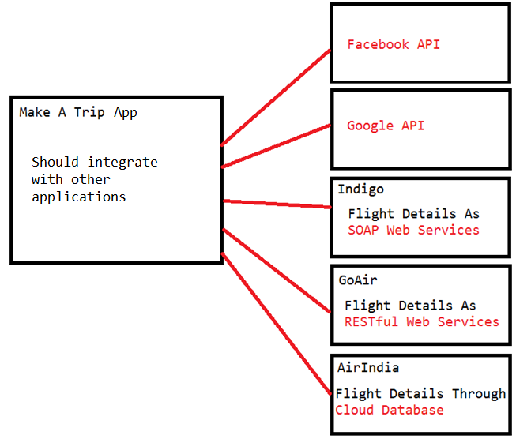
All Integrations

Slide 12
Best way to integrate
Make sure the client side code never requires to be changed
Loose coupling
Logical coupling

Slide 13
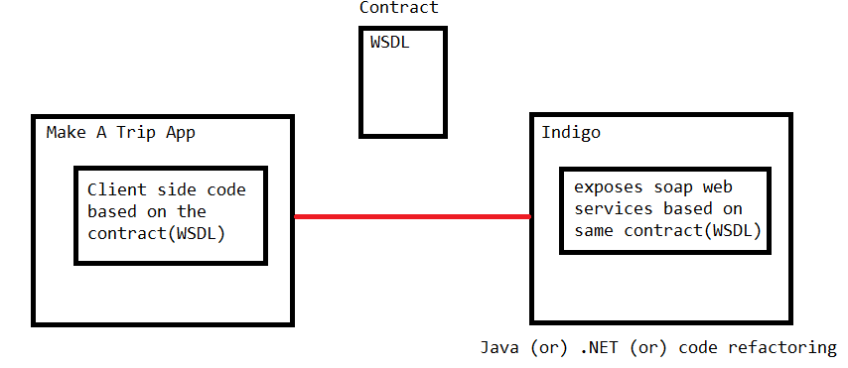
Loose coupling
Integrate two applications with a contract

Slide 14
As long as the contract remains same, the client is not required to change its code though the code is changed on service side.
i.e. The service is free to change its logic as well as the implementation.
Service can be implemented by C or C++, it is free to migrate to Java or .NET as long as it follows the contract.

Slide 15
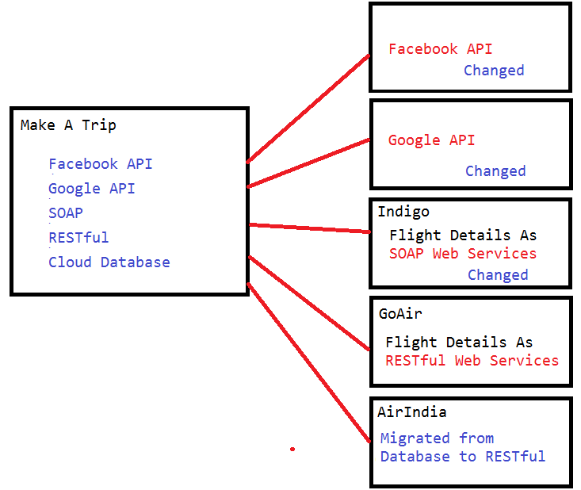
Change in the contract

Slide 16
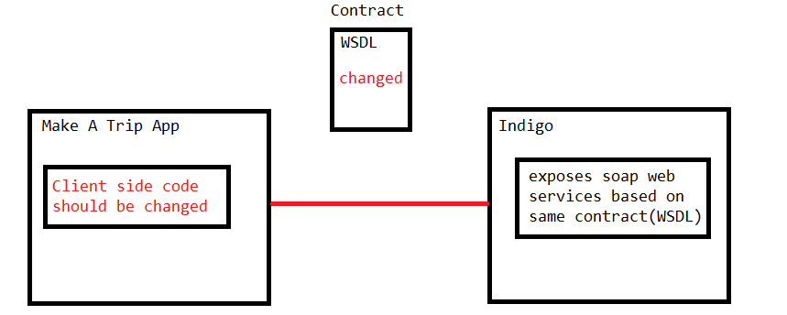
Client side code changes
What if Endpoint url is changed,
or one web service is split into two web services
or the response property names are changed.

Slide 17
Logical coupling
Though the contract is changed, the client side code is not required to be change.
To achieve this, the client should not know any details about the service and vice versa.
So the client and service should be completely isolated by using a middleware server i.e. MOM (Message Oriented Middleware).

Slide 18
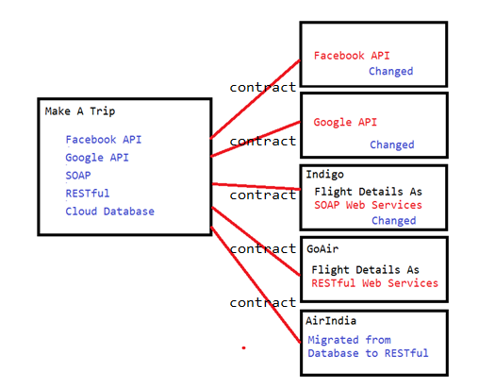
Point to Point Integration
Can achieve loose coupling but not logical coupling
To achieve logical coupling, the integration architecture should be changed.

Slide 19
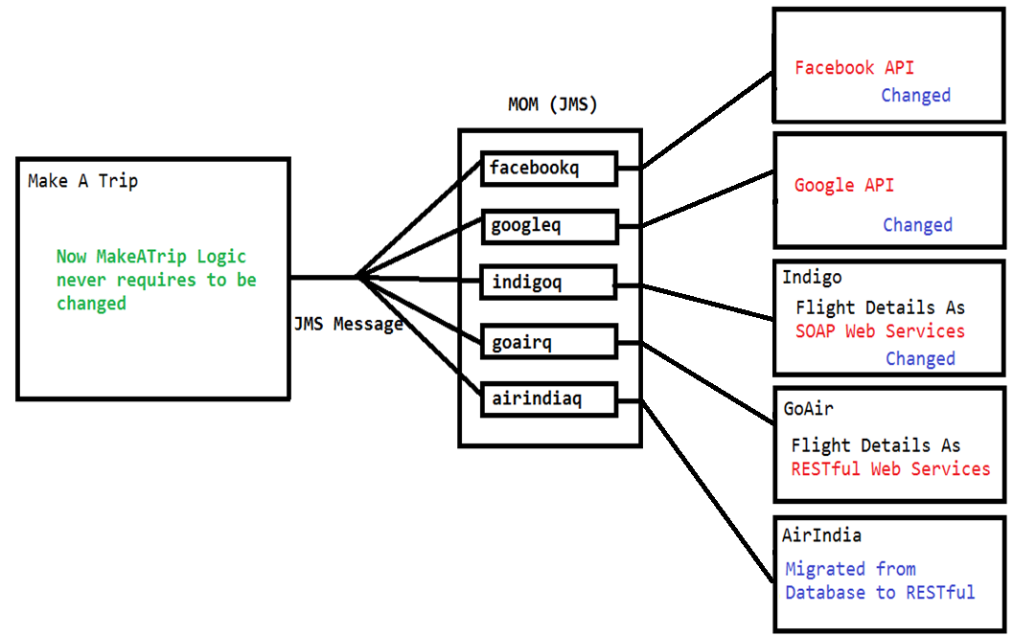
Integration architecture for logical coupling
Client needs to know only
How to create a JMS message
Send the JMS message to corresponding JMS queue

Slide 20
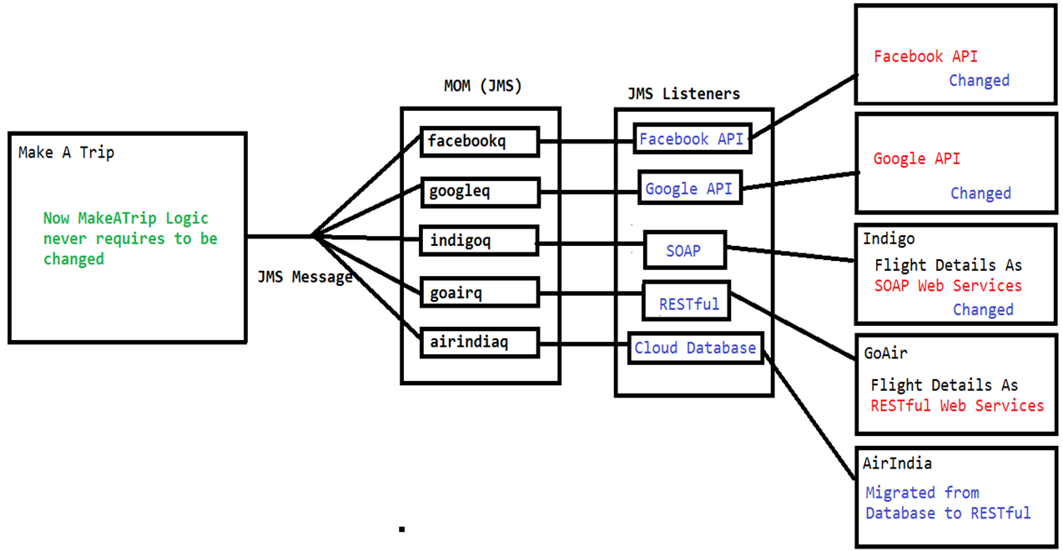
Integration architecture for logical coupling
JMS listeners should be implemented
For each and every queue in the JMS
For receiving JMS messages and send them to the API’s

Slide 21
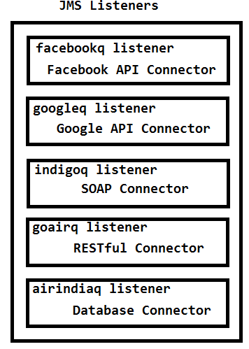
Take closer look at JMS listeners
Each JMS listener contains logic
To receive JMS message
To connect to the right side applications i.e. Connector logic

Slide 22
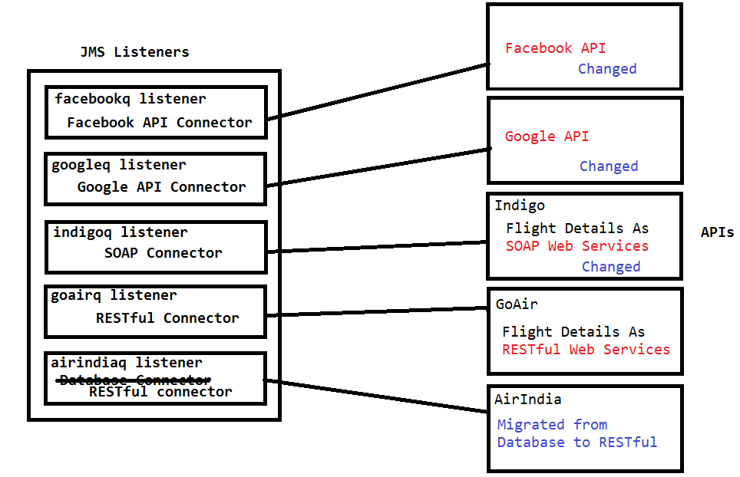
Advantages of this architecture
If contract changes on the right side applications, the corresponding changes can be made in the JMS listeners
We can simply remove Database connector and keep RESTful connector in the airindiaq listener
Instead of changing code in the Make A Trip app, we have to change in JMS listeners
But what makes different? (Will be discussed)

Slide 23
Issues to be faced by developers
Implement lot of JMS listeners
Implement various connectors like Facebook connector, Google connector, SOAP, RESTful, Database connector.
The overhead of JMS middleware.

Slide 24
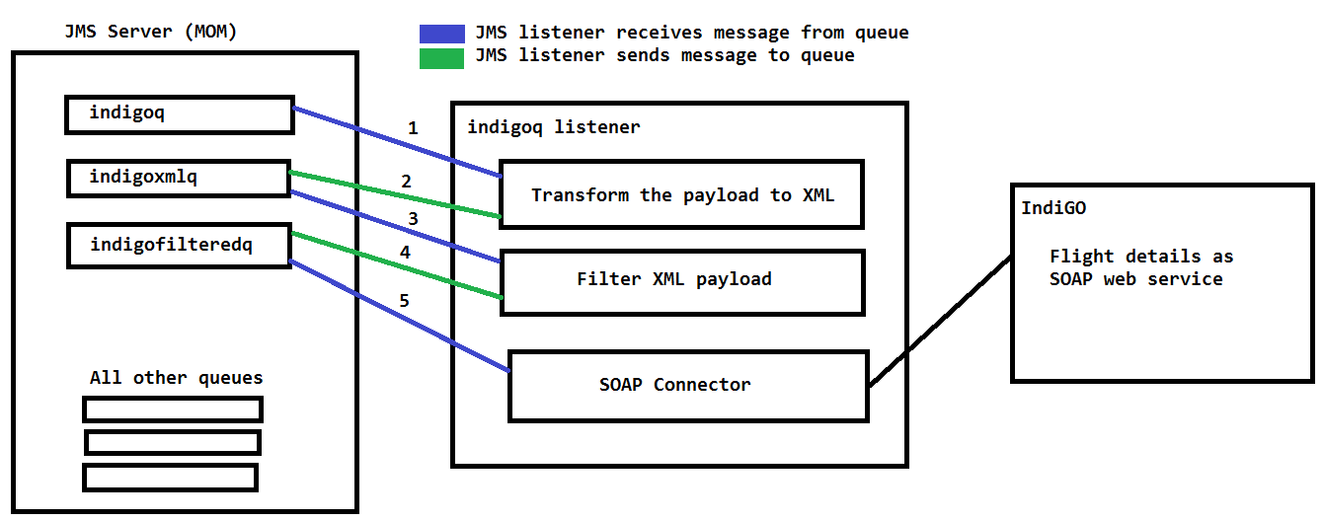

Slide 25
Issues to be faced by developers
Implement lot of JMS listeners
Implement various connectors like Facebook connector, Google connector, SOAP, RESTful, Database connector.
Implement various payload transformers
Implement various filters and routers
Using JMS queues to interconnect multiple components is costly.
The overhead of JMS middleware.

Slide 26
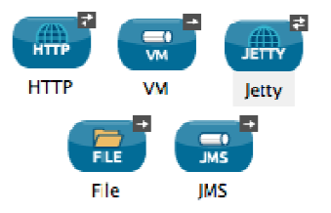
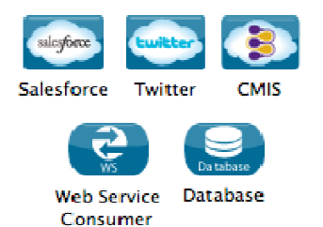
How mule makes developers life easy
Connectors
More than 120 predefined connectors
Endpoint based connectors
Operation based connectors

Slide 27
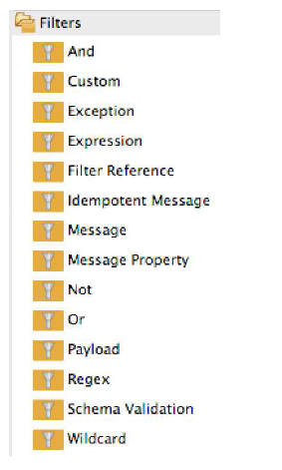
Filters
Mule provides so many predefined filter to filter the requests based on conditions.

Slide 28
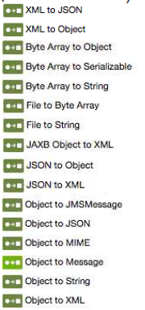
Transformers
Mule provides various transformers to transform the payload from one representation to other

Slide 29
Routers
To perform unicasting
To perform multicasting
In-memory queues
To reduce the overhead cased by JMS interactions

Slide 30
Other features
Error handling
Enterprise services like security
A way to expose RESTful web services
Batch processing
Cloud deployments
On-premises deployments

Slide 31
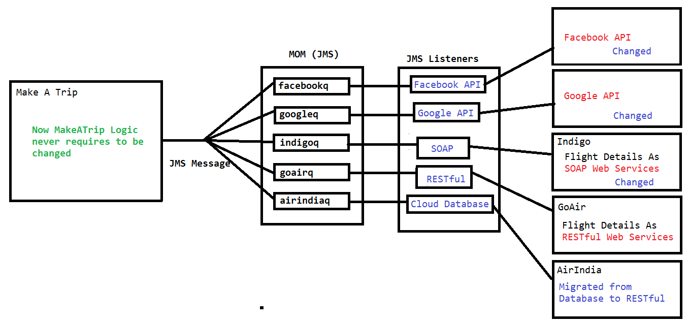
MakeATrip App without Mule

Slide 32
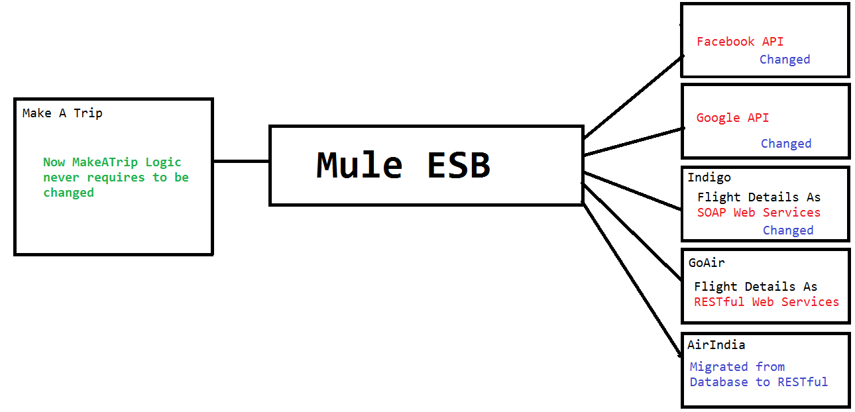
MakeATrip App with Mule
HTTP
JMS

Slide 33
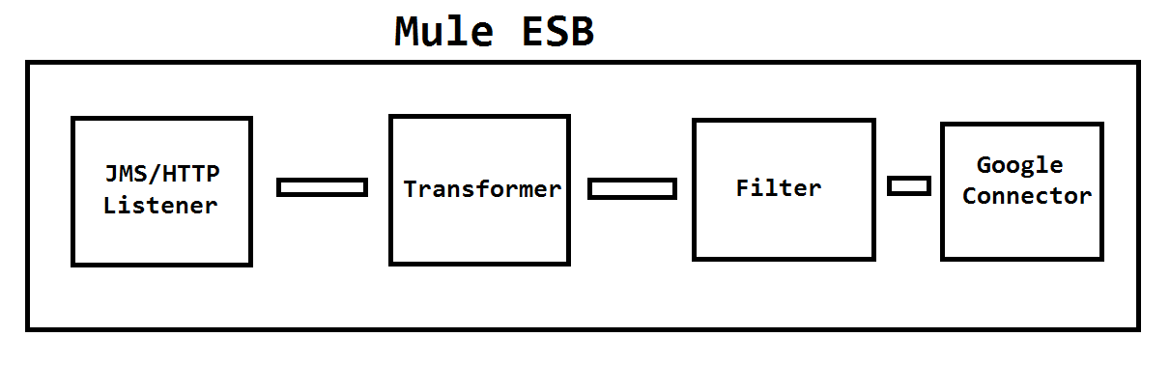
Mule ESB
Mule ESB contains set of message processors interconnected through in-memory queues
So it is called as BUS
But Mule provides enterprise services as well so called as ESB (Enterprise Service BUS)

Slide 34
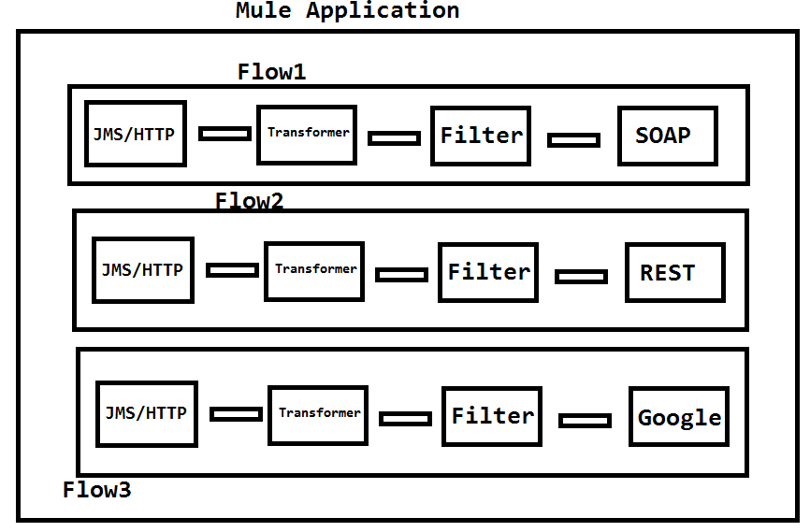
Mule Application

Slide 35
Mule Flow
Mule flows are xml code.
No need to write xml.
Drag and drop components from the palette into the mule xml canvas, so mule generates xml implicitly.
Then deploy the mule flows(i.e. Mule application) in mule server

Slide 36
Mule Server
Is not web server (does not implement J2EE spec)
Not an application server.
Is a JVM based server.
Is nothing but a Java program that can simultaneously run multiple mule applications using multiple threads.

